Slide 1

This Template Respects
Stockholm University Neuroscience Guidance
Presentation Optimized for:
Presenting to Audience
ONE
CONTRAST
SIZE
SENTENCES
DARK
SIX

Slide 2

automation
Guide

Slide 3

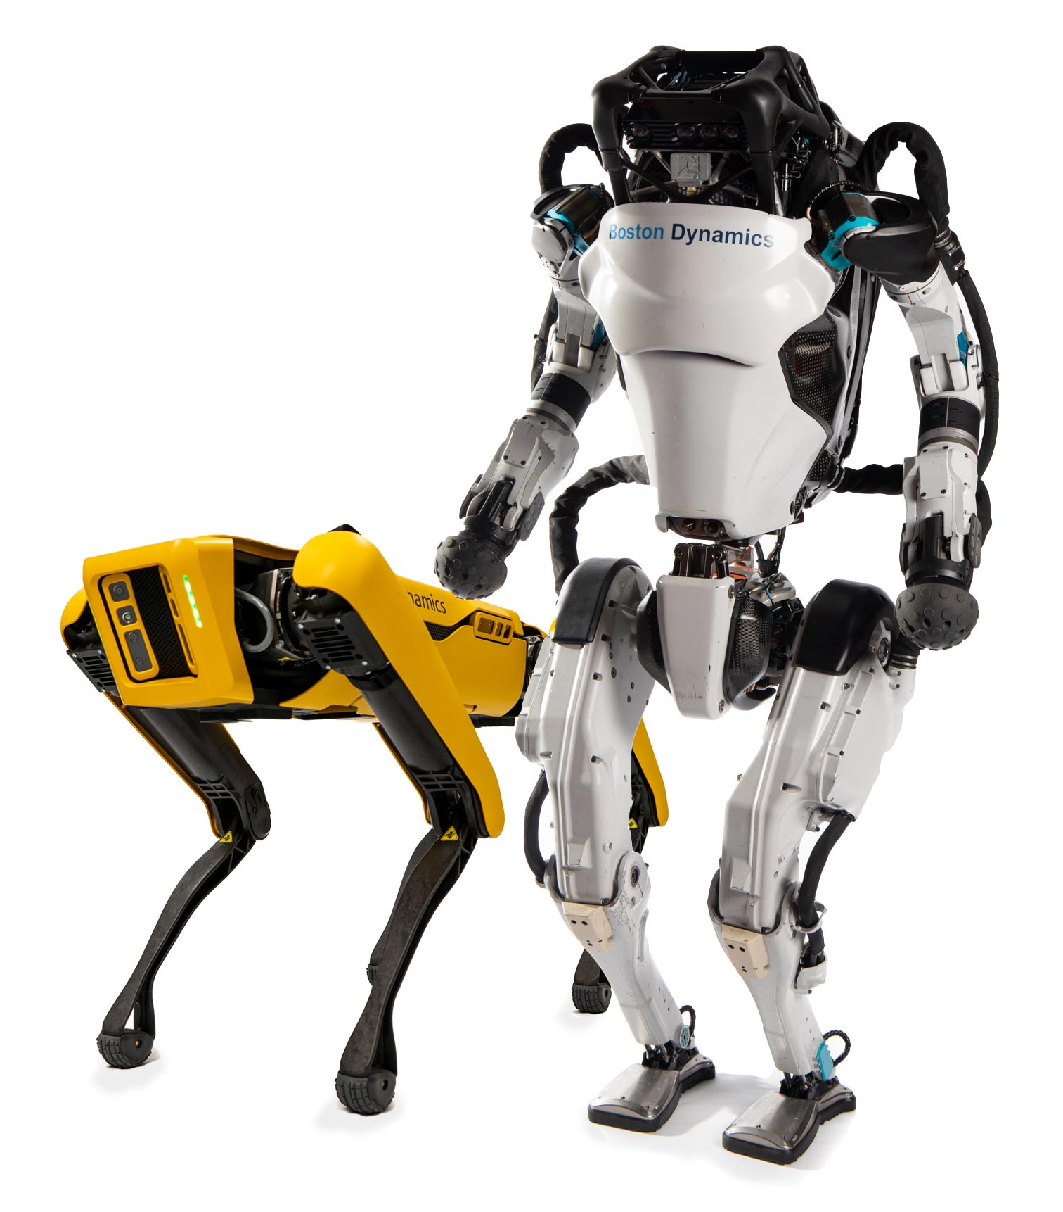
TWO KINDS OF AUTOMATION
HARDWARE
SOFTWARE

Slide 4
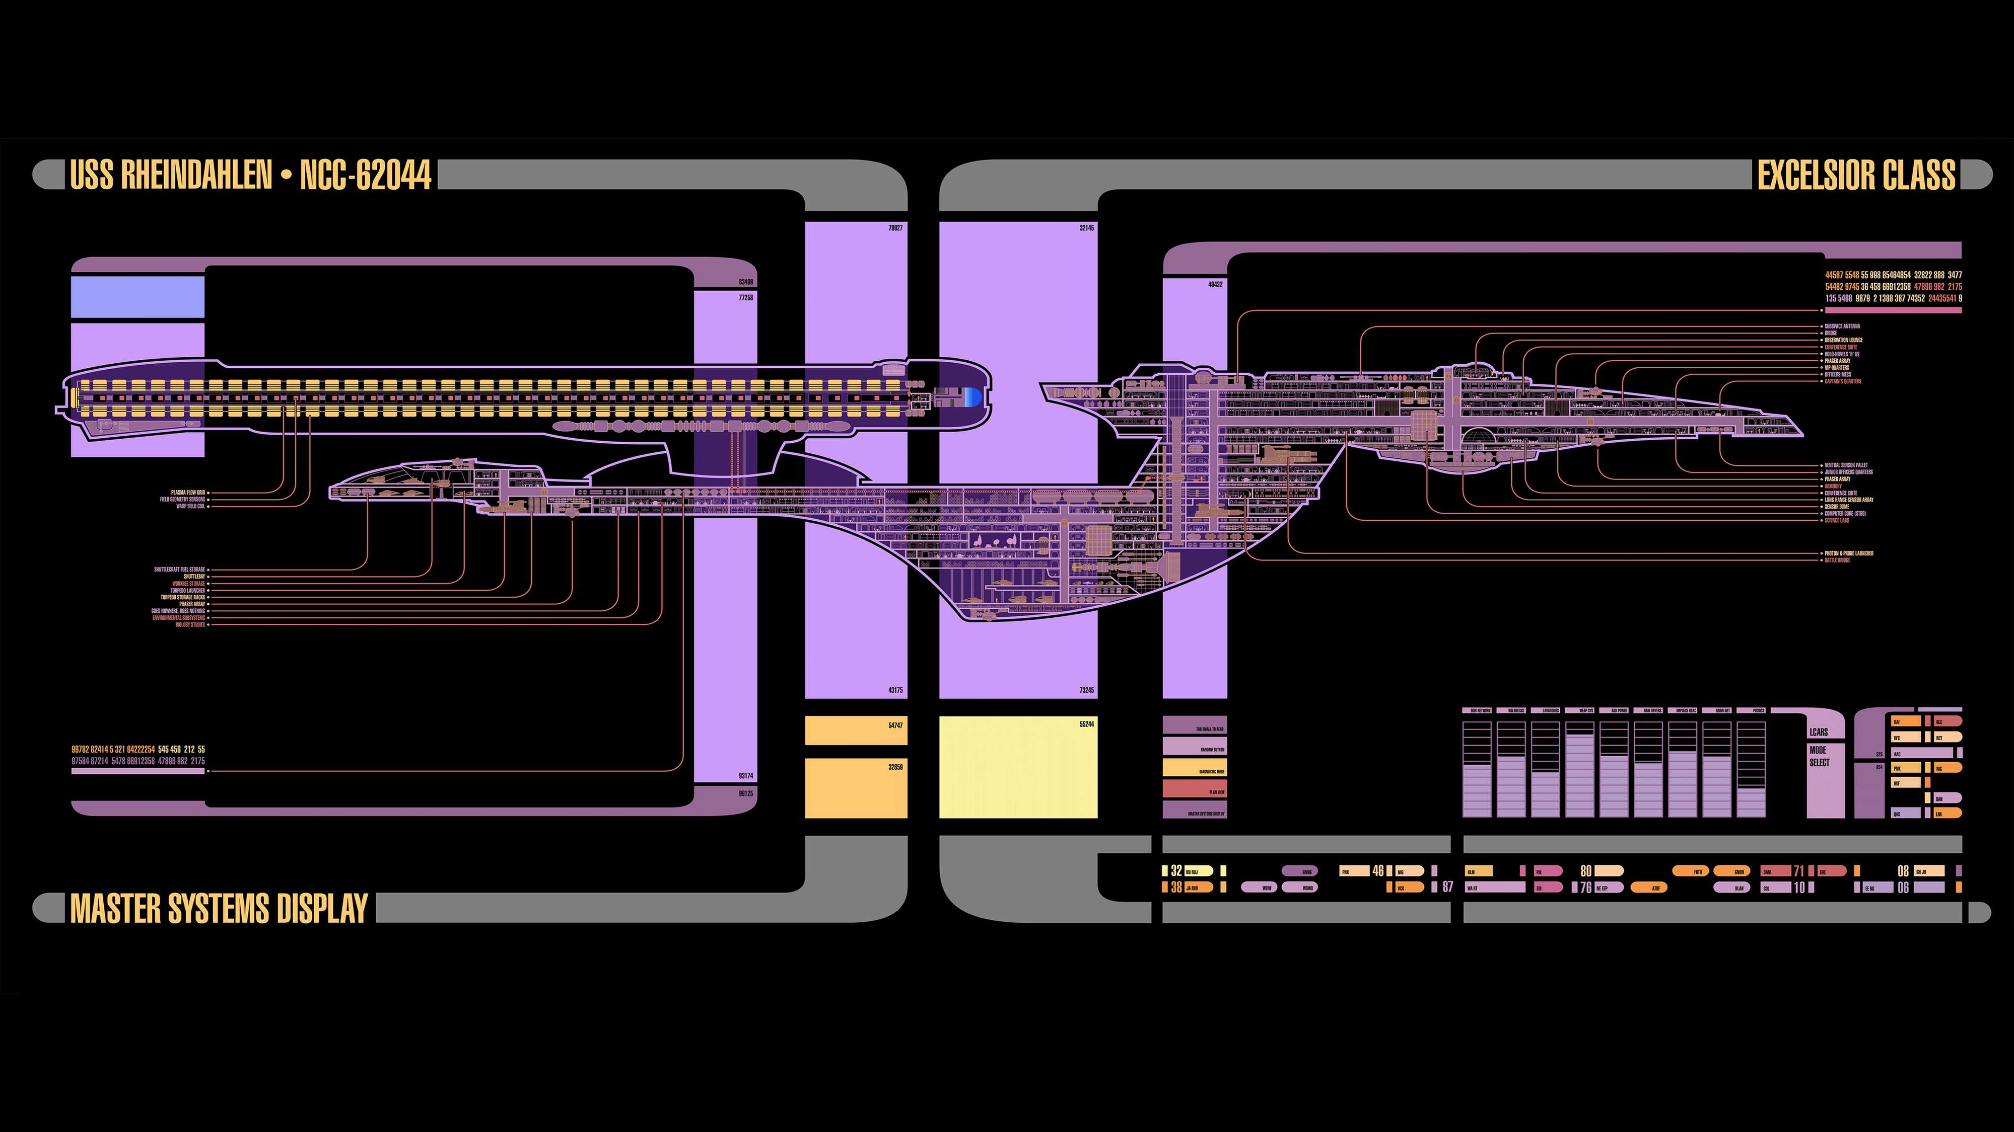
SOFTWARE automation
IS HALF THE FUTURE

Slide 5

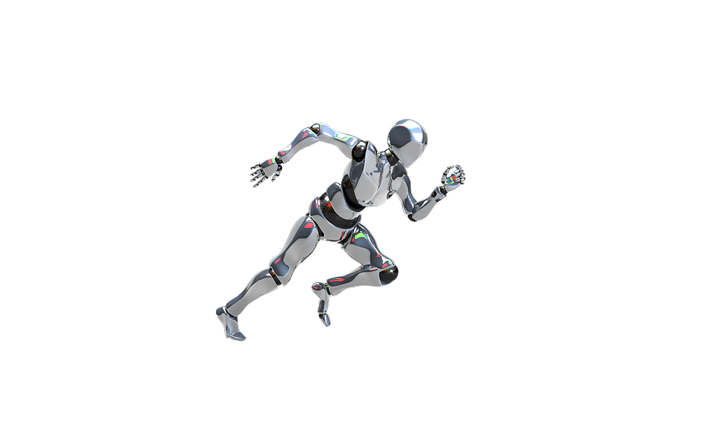
AGENDA
BACKGROUND AND POTENTIAL
GO TO MARKET
BUSINESS CASE AND RISKS
WHO BENEFITS

Slide 6










Robotic Process Automation is a way to automate manual labor
RPA is…
RPA is not…
RPA can…
Benefits of RPA…
Computer-coded software
Walking talking auto-bots
Opening email and attachments
Scraping data from the web
Increased efficiency
Logging into web/ enterprise applications
Connecting to system API
Programs that replaces humans performing repetitive tasks
Making calculations
Eliminates human error
Physically existing machines processing paper
Moving files and folders
Extracting structured data from documents
Copying and pasting
Collecting social media statistics
24/7 productivity
Cross-functional and cross-application macros
A complete full automation enterprise system
Filling in forms
Reading and writing to databases
Following “if/then” decisions/rules
100% accuracy
Smart Macros

Slide 7
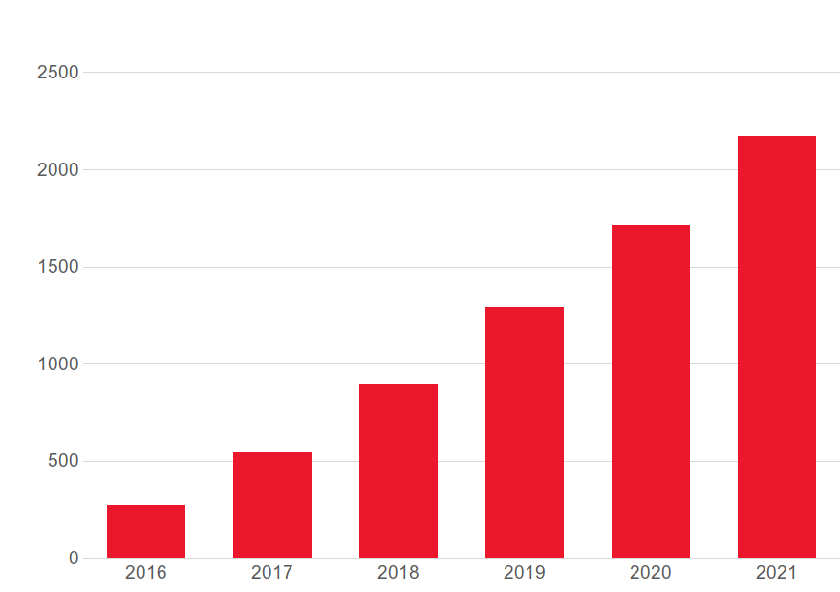
RPA is growing rapidly
RPA worldwide market revenue (M$)

Slide 8
from transactional automation to cognitive solutions
Maturity
Cognitive Solutions
Characteristics:
Unfixed rules
Behavior recognition
Machine learning
Process examples:
Virtual SMO advisor
Process enhancement
virtual advisory
Analytical Unstructured Data Processing
Characteristics:
Natural language processing
Unstructured data
Artificial intelligence
Process examples:
Chat-bots
Service desk
Knowledge base
Transactional Automation
Characteristics:
Repetitive manual tasks
Fixed process-tasks
High-volume tasks
Process examples:
HR on/off-boarding
It operations mgmt
Self-healing
Complexity

Slide 9

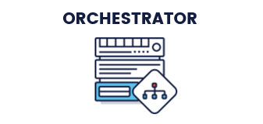

Building Blocks
RPA Workflow Canvas
Command Console
Virtual
Worker
Visio-like Ease of use
Process Recorders
Citrix Wizards
Intelligent Mgmt.
Point/Click Reporting
Enterprise-tier Security
One robot, double specialization for Front & Back Office automaton
Highly accurate Computer Vision technology
Self-healing

Slide 10
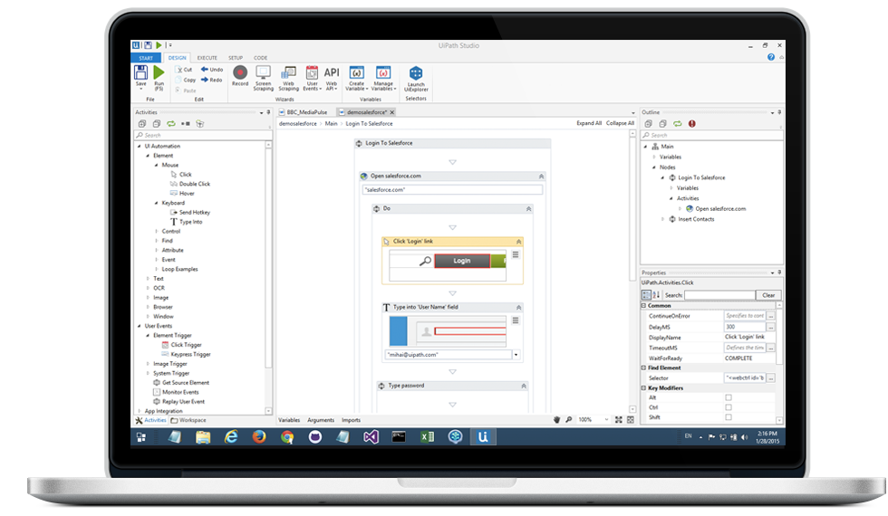
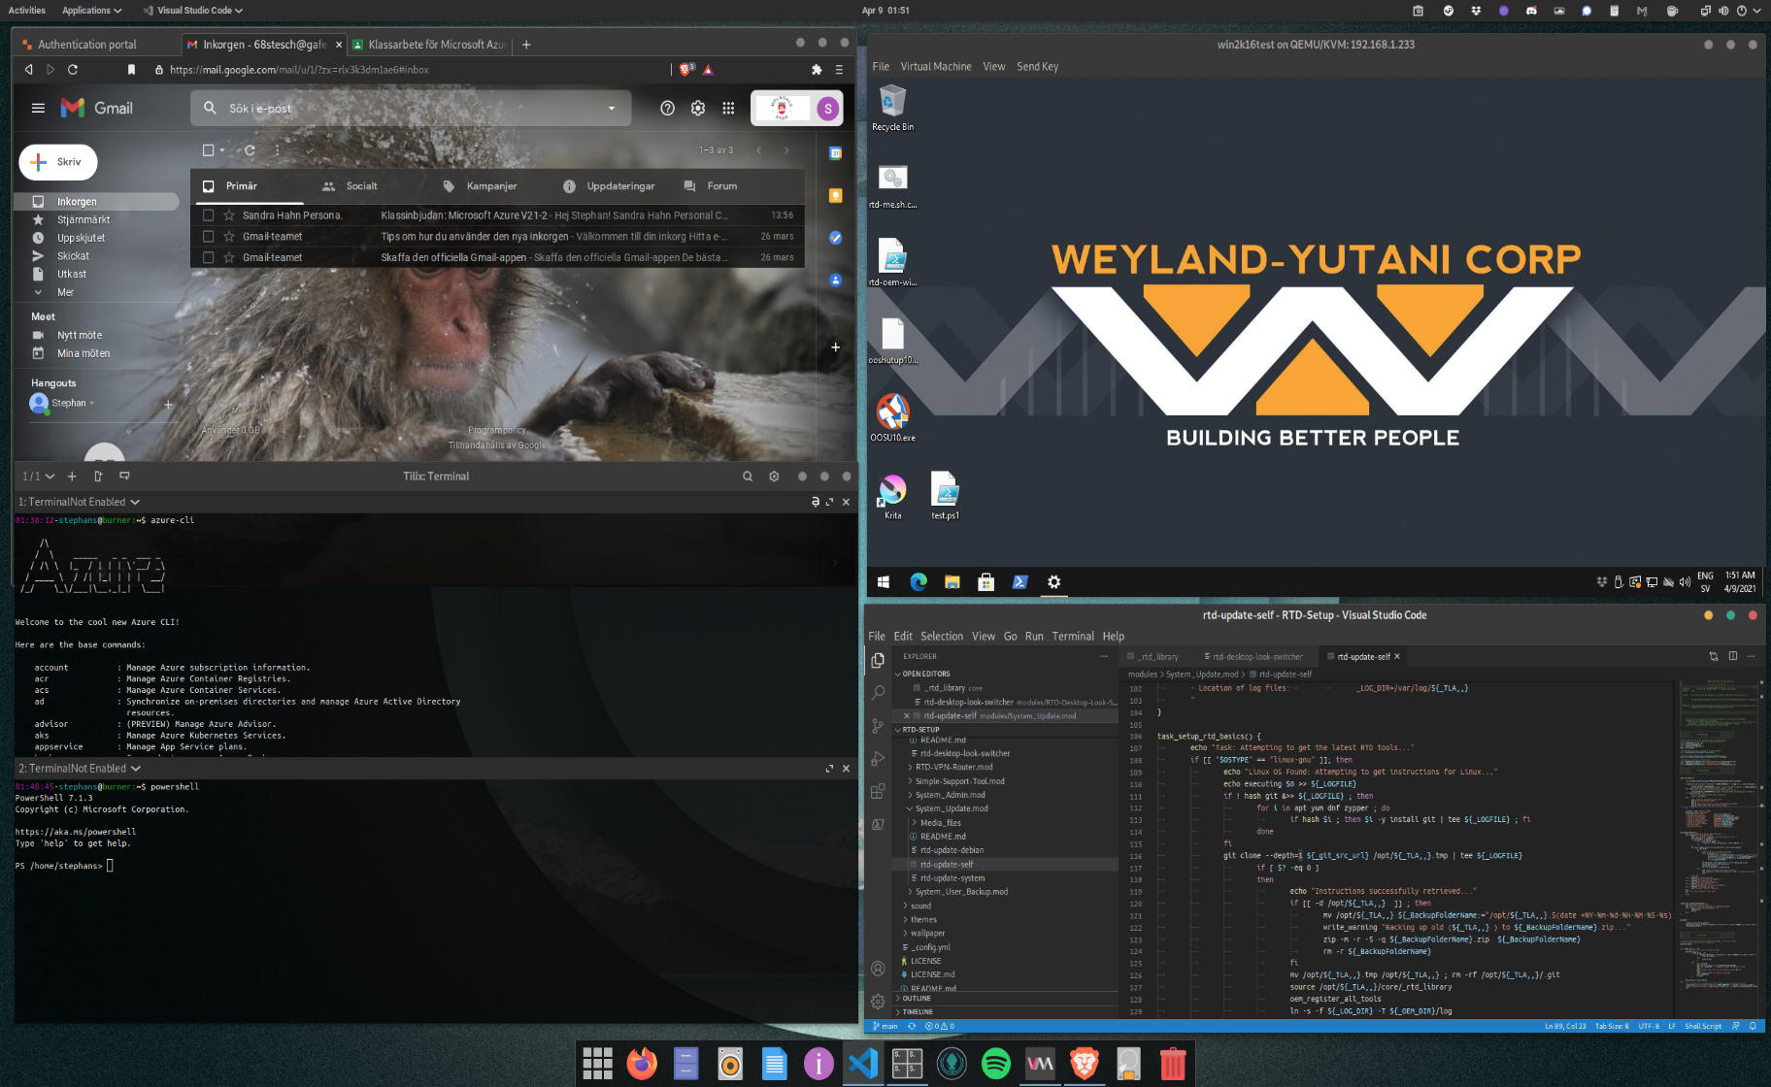
Robots impersonate a user
Anything you usually do at your computer
Specially repetitive tasks
But not true content creation

Slide 11
AGENDA
BACKGROUND AND POTENTIAL
GO TO MARKET
BUSINESS CASE AND RISKS
WHO BENEFITS

Slide 12
implementation
Record processes
Testing
  Prepare basic user credentials
  Setup robot connectivity
  Gather process documentation
  Record process
  Reproduce process steps manually
  Prepare implementation plan
  Train/configure the robots
  Document implementation
  Validate process execution
  Execute UAT
  Update process documentation
  Prepare for production deployment
Preparations
Implement robots
Time

Slide 13
AGENDA
BACKGROUND AND POTENTIAL
GO TO MARKET
BUSINESS CASE AND RISKS
WHO BENEFITS

Slide 14



BENEFITS of AUTOMATION
Shareholder value
  Operational efficiency
  High ROI in year one
  Better regulatory compliance
  Improved scalability
  More flexible workforce
  Delivering competitive advantage
Customer experience
  Improved service quality
  Faster delivery of existing services
  Improved service consistency
  Round-the-clock availability
  New services online quickly
  Enhanced customer journeys
Employee satisfaction
  Higher job satisfaction
  New skills
  Liberation from dreary tasks
  Becoming known as an innovator

Slide 15







Risks and mitigation
MITIGATION
RISKS
Security: Can robots be hijacked?
Executive: Have the right people bought in?
Technical: How will testing work?
Change management: Who manages communication?
Operational: What controls exist to monitor performance?
Functional: Who designs controls?
Go for early success
Treat RPA like any critical project
Take your time
Focus on education
Simple is better
Manage bots carefully
Communicate early and often

Slide 16
AGENDA
BACKGROUND AND POTENTIAL
GO TO MARKET
BUSINESS CASE AND RISKS
WHO BENEFITS

Slide 17






Different sized companies needs to be targeted differently
Large companies
Has the resources and often the strategic aspiration to target full automation
Full automation
Automates an entire process
Tightly integrated
Fast and efficient service
High initial cost
BIG
Medium-sized companies
Benefit enough to justify an investment in automation technology
Robotic Process Automation (RPA)
Existing human/ computer interfaces
Low cost
Quick implementation
MEDIUM
Small companies
Less likely to have the resources to implement RPA on a larger scale
Workflow-based
Manual defined workflows
SMALL

Slide 18









Target industries
THE CASE FOR AUTOMATION
BENEFITS
AFFECTS ALL INDUSTRIES
Standardized and predictive
<<<<<<<<
Finance and banking
Faster service delivery and improved quality in Financial Services
Manual and repetitive
Low variation
Insurance
High Automation Business Case
Improved operational efficiency and enhanced customer journey in IT services
Retail
Mature
All- electronic
Improved scalability and more interesting tasks in Human Resources
High transaction rate
Public sector
Improved efficiency and round-the-clock availability in Sales Operations
Other industries

Slide 19

END OF PRESENTATION

